Slide 1
Indian Street food
By Abhishek

Slide 2
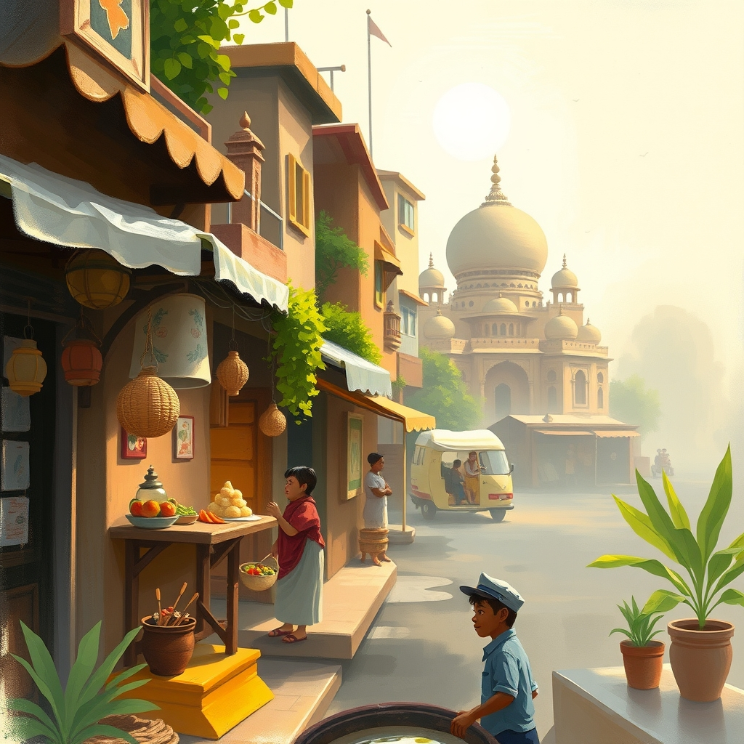
Introduction: A Culinary Journey Through India's Streets
What is Indian Street Food? Define and highlight its importance in Indian culture.
Overview of the diversity and regional variations in street food.
Hook: Share a captivating image of vibrant Indian street food.

Slide 3
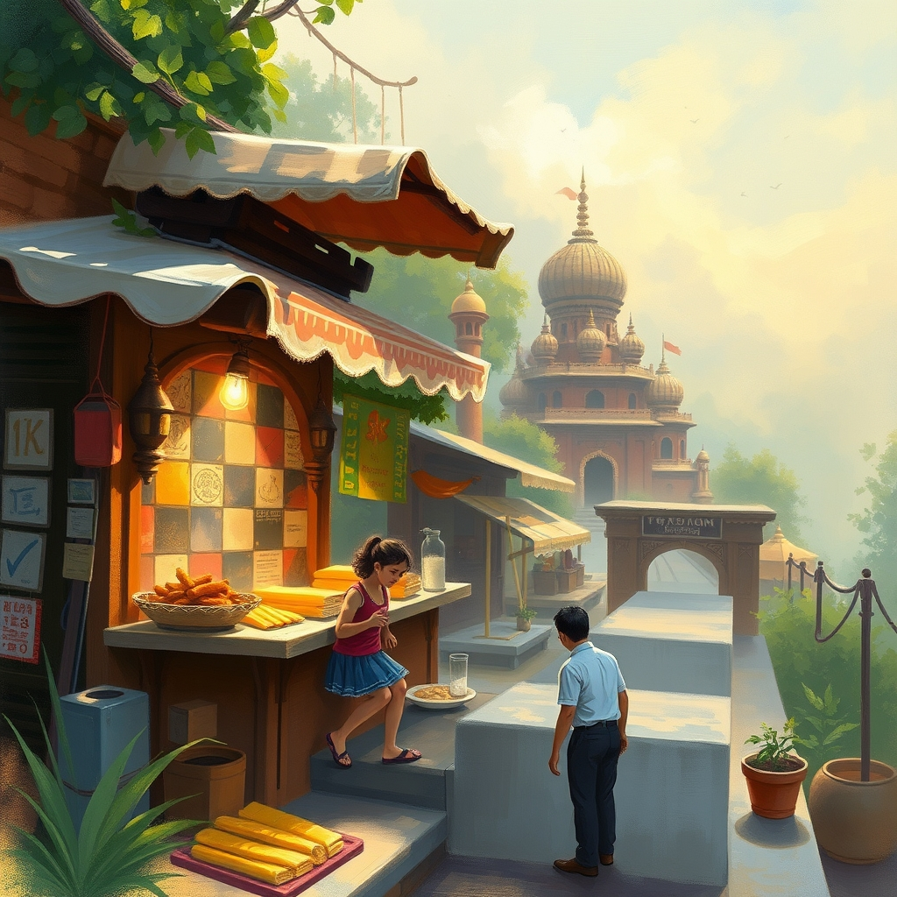
Popular Street Food Delights: North India
Gol Gappe/Pani Puri: Description, ingredients, and regional variations.
Aloo Tikki: Description, preparation, and serving styles.
Chole Bhature: Description, ingredients, and why it's a breakfast favorite.
Quick note on Chaat: its importance and its prevalence

Slide 4

Popular Street Food Delights: South India
Dosa: Varieties (Masala, Plain), sambar, and chutney accompaniments.
Idli and Vada: Description, dipping sauces, and popular combinations.
Bhel Puri: Ingredients and flavors, and unique preparation.

Slide 5

The Appeal of Indian Street Food
Affordability and Accessibility: Why it's a staple for many Indians.
Freshness and Flavor: Emphasis on freshly prepared ingredients and spices.
Social and Cultural Significance: Street food as a gathering point.
Hygiene and safety concerns

Slide 6

Conclusion: A Taste of India on Every Corner
Recap of the diversity and appeal of Indian street food.
Emphasize the unique culinary experience it offers.
Call to action: Encourage exploration and responsible consumption of street food.
Include a closing image showcasing a bustling street food scene.

Slide 7
Thank You!

